Slide 1
Better Together: Text + Context Final Presentation
Aug 3, 2023
https://github.com/kwchurch/JSALT_Better_Together

Slide 2
Agenda
1.5 hours
1.5 hours
Intro (Ken) – 20 minutes
Centroids/Related Work
(Rodolfo) – 15 minutes
Bins
(Shabnam) – 15 minutes
Forecasting over time
Losses + Time & Space
Production Runs
(Ben) – 10 minutes
Time & Space
Break – 30 minutes
Experiments
Perplexity (Abteen) – 20 minutes
Random Walks (Peter) – 10 minutes
Link Prediction (Peter) – 10 minutes
Time prediction (Melissa) – 15 minutes
GNNs (Sandeep, Hui) – 15 minutes
Deliverables/Conclusions
(Ken) – 5 minutes
Questions – 15 minutes

Slide 3
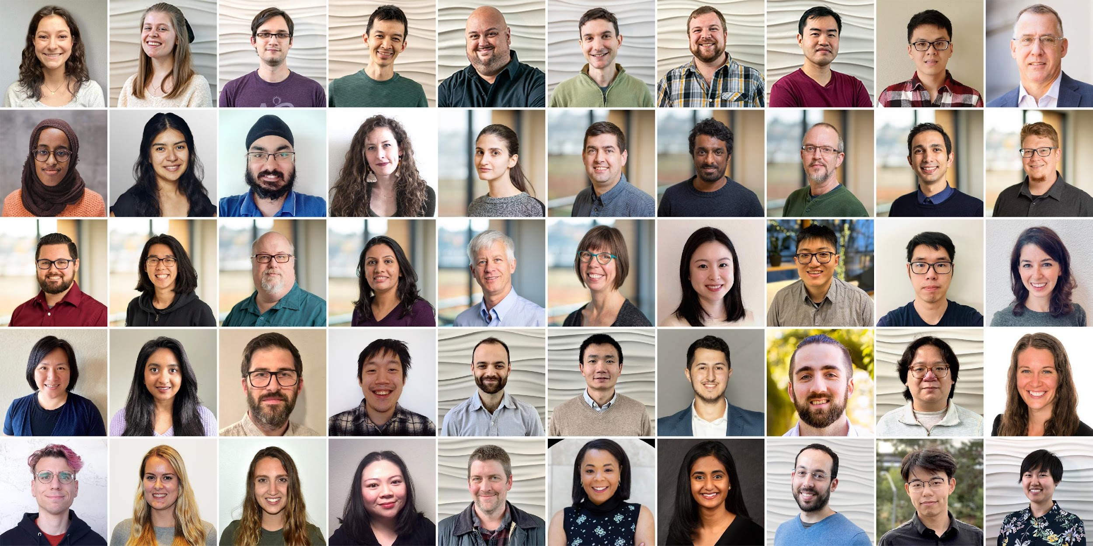
Semantic Scholar (S2): Significant Effort (slide from Dan Weld)
50 person team
7 year project
207M+ scientific paper index
8M+ monthly active users

Slide 4
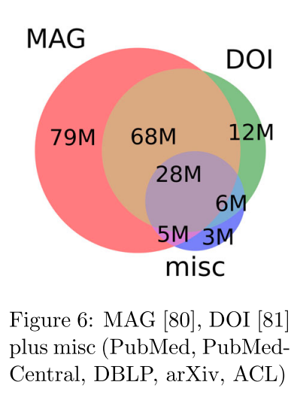
Semantic Scholar (S2)
Seven Sources
Fields of Study
Medicine (45M) | Engineering (8M) | Business (4M) | Geology (3M)
Chemistry (13M) | Physics (7M) | Sociology (3M) | History (2M)
Computer Science (13M) | Psychology (7M) | Geography (3M) | Art (2M)
Biology (13M) | Mathematics (5M) | Economics (3M) | Philosophy (1M)
Materials Science (10M) | Political Science (4M) | Environmental Science (3M)

Slide 5
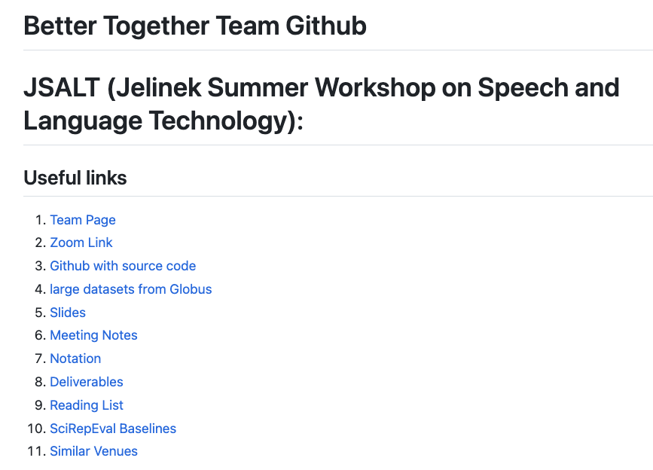
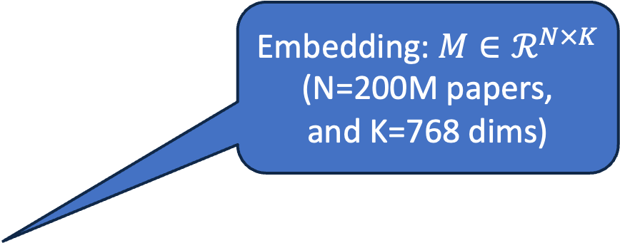
https://github.com/kwchurch/JSALT_Better_Together
Embedding: $M∈ℛ^{N×K}$
(N=200M papers,
and K=768 dims)
including these slides

Slide 6

Better Together: Text (Titles, Abstracts, Body); Context (Citations)
Specter, SciNCL
ProNE

Slide 7
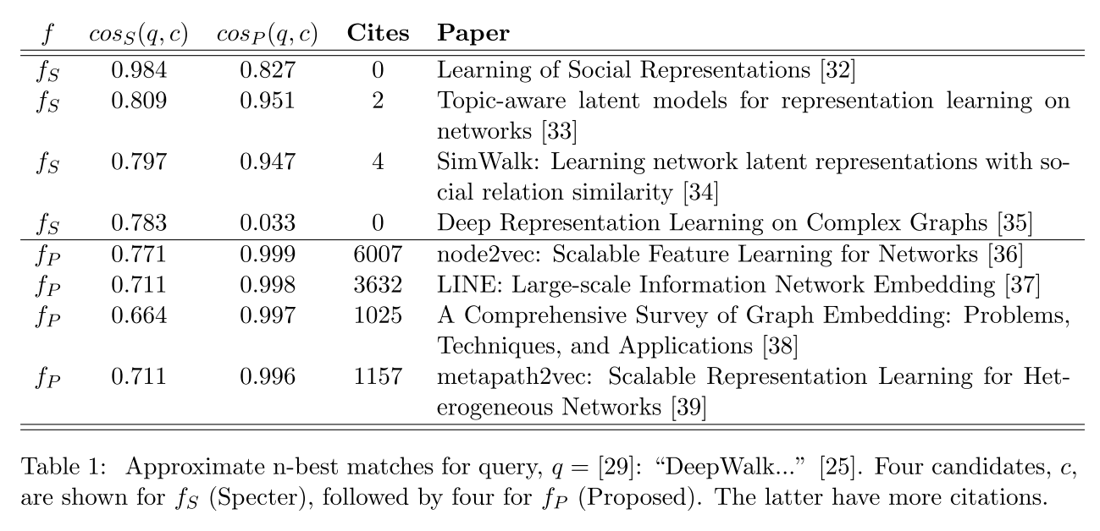
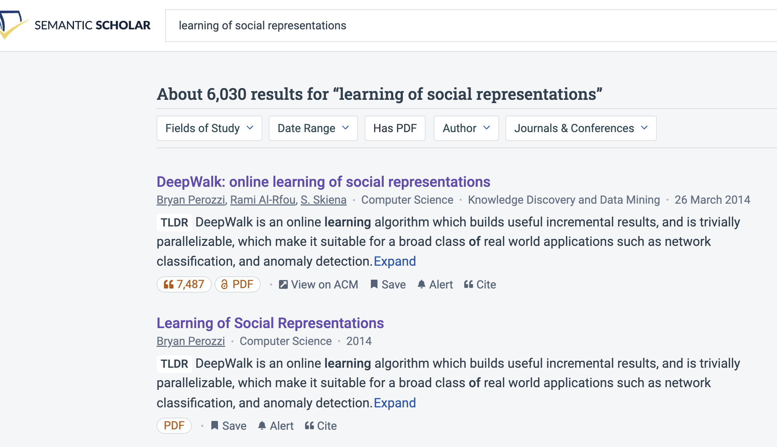
Query: ``DeepWalk: Online Learning of…’’

Slide 8
Document Similarities: Use Cases
Recommendations
What should I read?
What should I cite?
Many systems focus on ``relevance’’ (word overlap)
But we also want credibility
Don’t recommend papers that are buzz-word compliant
But not worth reading
(Most papers are never cited)

Slide 9
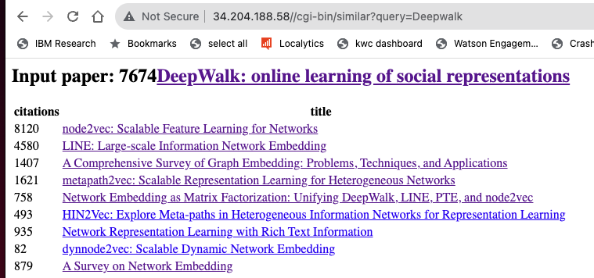
Web Server

Slide 10
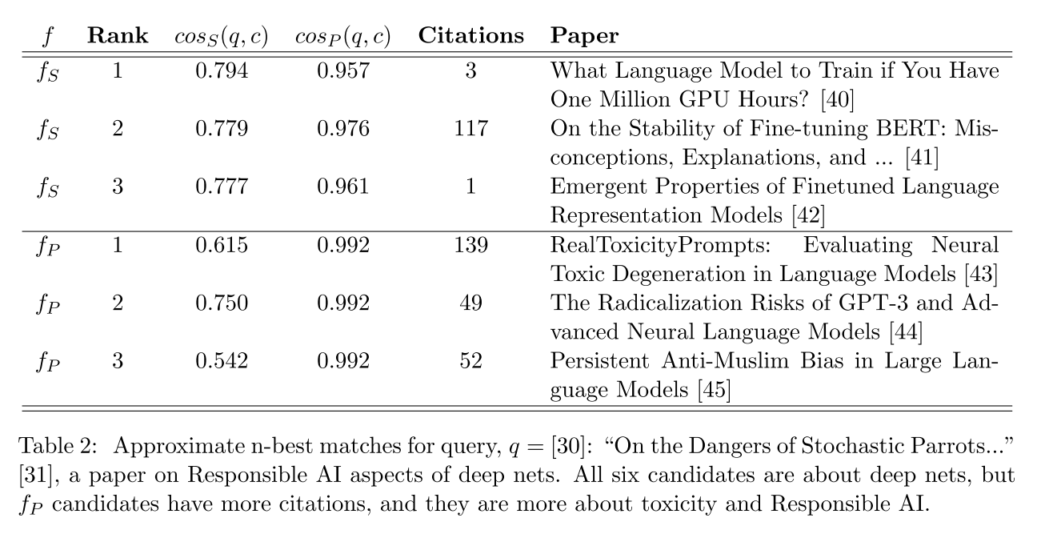
Query: ``On the Dangers of Stochastic Parrots…’’

Slide 11
Deliverables
GitHub:
massive (but needs editing)
slides, code, reading list
pointers to large files on Globus
Web Server
Recommendations
Input: queries for documents
Output: recommendations (docs)
What Should I read? Cite?
Resources
Data behind web server:
citation graph
embeddings
indexes for approx. nearest neighbors
pairs of corpusIds with large cosines
all of the above for
Specter1, Specter2, SciNCL, ProNE
x100 bins for ProNE
Evaluations & Benchmarks
Intrinsic and Extrinsic evaluations
Perplexity, Random Walks, Link Prediction

Slide 12
Opportunities
Scale
Prediction
Many benchmarks return a single number (figure of merit)
How does performance scale
with the size of the problem?
Standard test/train splits
More relevant to interpolation
than extrapolation
Time is asymmetric
It is difficult to make predictions
especially about the future
-- Yogi Berra

Slide 13
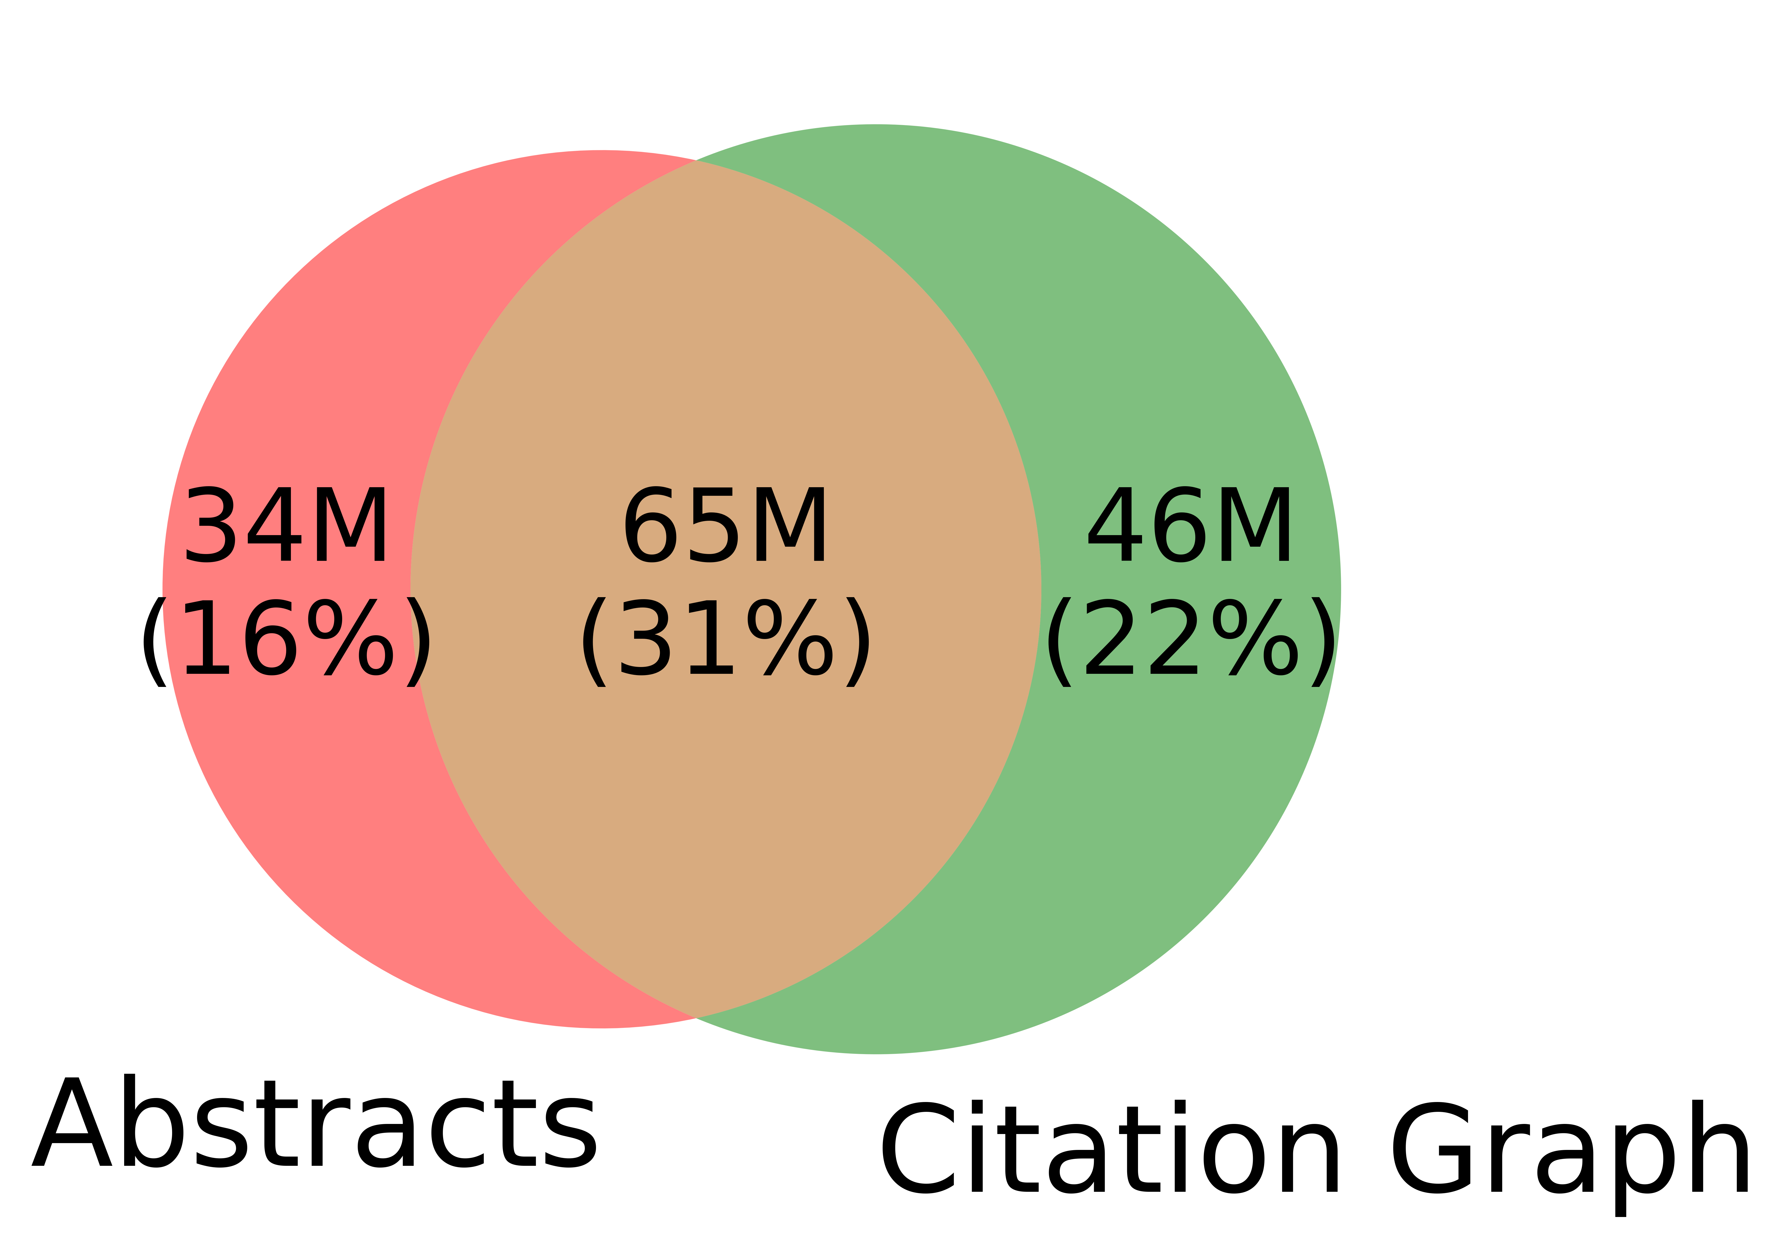
Spoiler Alert: Better-Together Conjectures
Multiple representations are helpful
for missing values (and bad values)
If abstracts are missing, use links
If links are missing, use abstracts
and for graphs of different sizes
When graphs are small:
Text >> Links
when graphs are large:
Links >> Text (Metcalfe’s Law)

Slide 14
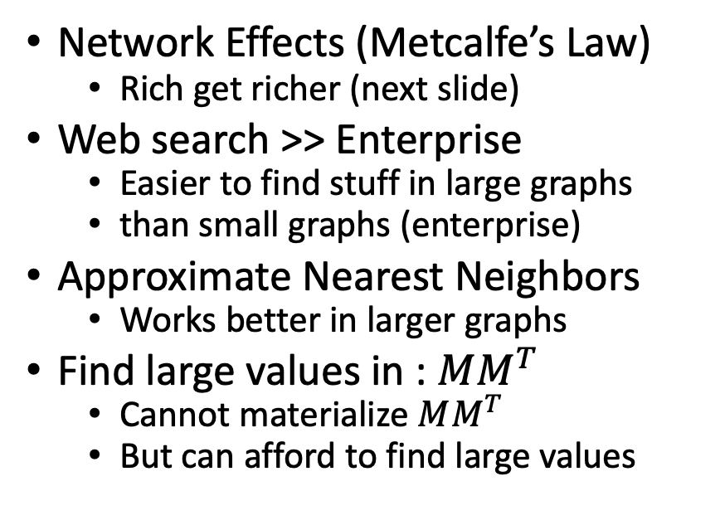
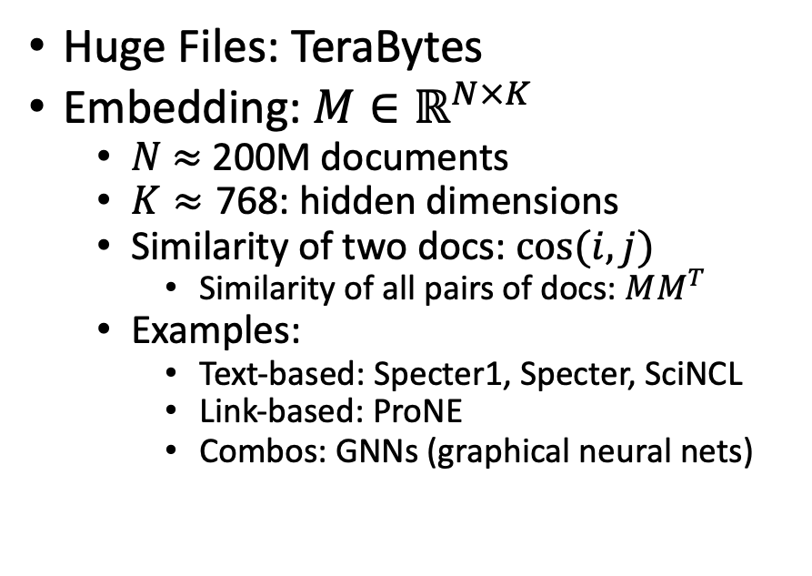
Scale: Both a Blessing and a Curse
Curse
Blessing
Huge Files: TeraBytes
Embedding: $M∈ℝ^{N×K}$
$N$ $≈$ 200M documents
$K≈\text{768}$: hidden dimensions
Similarity of two docs: $cos(i,j)⁡$
Similarity of all pairs of docs: $MM^{T}$
Examples:
Text-based: Specter1, Specter, SciNCL
Link-based: ProNE
Combos: GNNs (graphical neural nets)
Network Effects (Metcalfe’s Law)
Rich get richer (next slide)
Web search >> Enterprise
Easier to find stuff in large graphs
than small graphs (enterprise)
Approximate Nearest Neighbors
Works better in larger graphs
Find large values in : $MM^{T}$
Cannot materialize $MM^{T}$
But can afford to find large values

Slide 15


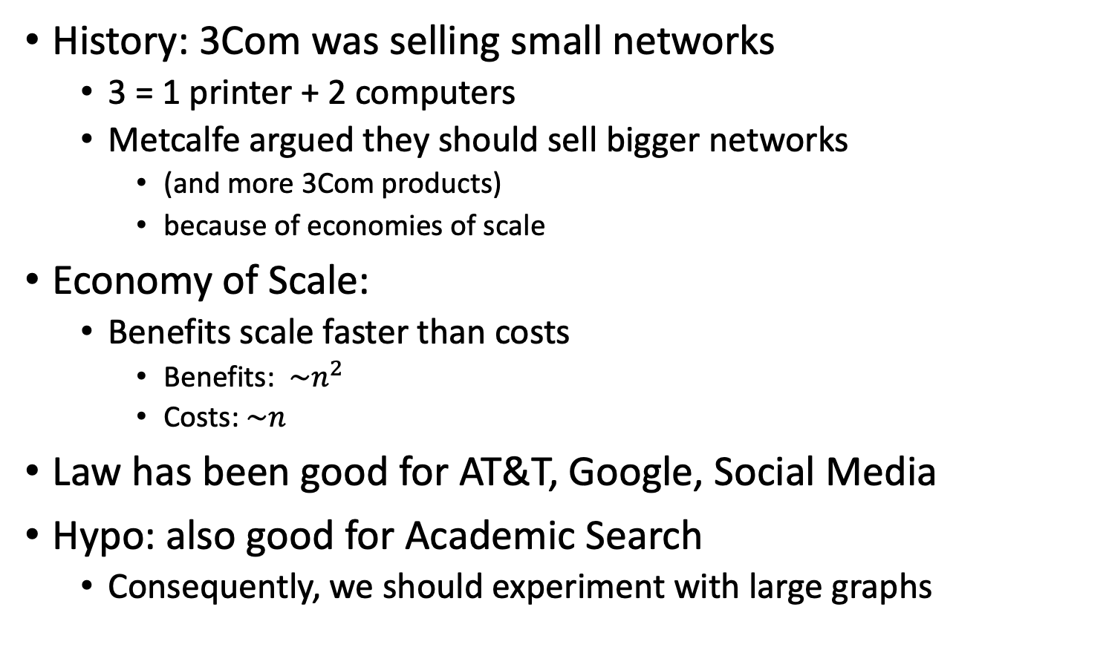
Metcalfe’s Law (Network Effects)
History: 3Com was selling small networks
3 = 1 printer + 2 computers
Metcalfe argued they should sell bigger networks
(and more 3Com products)
because of economies of scale
Economy of Scale:
Benefits scale faster than costs
Benefits: $\sim n^{2}$
Costs:$\sim n$
Law has been good for AT&T, Google, Social Media
Hypo: also good for Academic Search
Consequently, we should experiment with large graphs

Slide 16
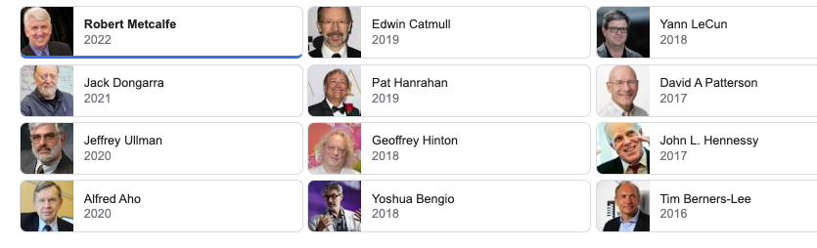
Turing Award/Winners

Slide 17
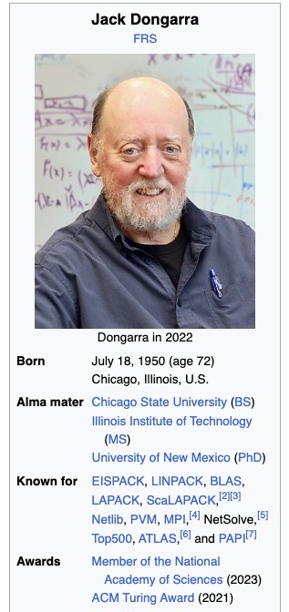
Turing Awards: Metcalfe’s Law, Deep Nets, Linear Algebra
Metclalfe’s Law: Metcalfe
Deep Nets: Hinton, Bengio, LeCun
Linear Algebra: Dongarra

Slide 18
Opportunities
Encourage practical solutions to real problems
Recommendations: What should I read? Cite?
Too many benchmarks are unrealistic (small, clean)
Realities
Literature is large and growing (doubles every 9 years)
Dirty Data (many values are missing/incorrect)
Scale
How do space, time and loss scale with size of citation graph?
Forecasting: short-term predictions are easier than long-term

Slide 19
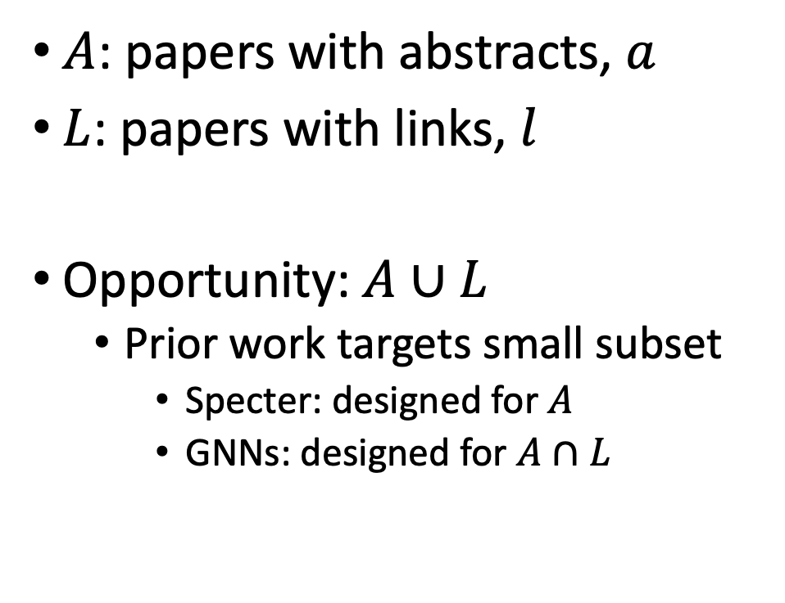
Realities: Missing Values
$A$: papers with abstracts, $a$
$L$: papers with links, $l$
Opportunity:$A∪L$
Prior work targets small subset
Specter: designed for $A$
GNNs: designed for $A∩L$
Other
(31%)

Slide 20
Realities
The Real World
Idealizations (Evaluation Benchmarks)
Large (Metcalfe’s Law)
Growing (next slide)
Dirty (previous slide)
Missing Values
Bad/misleading Values
Small
Static
Clean

Slide 21
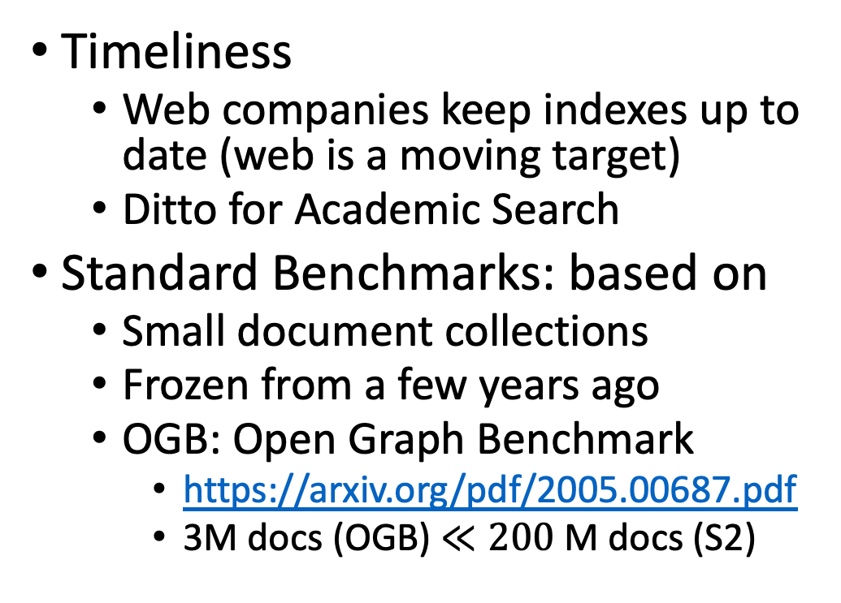
Global Scientific Output Doubles Every 9 Years
Timeliness
Web companies keep indexes up to date (web is a moving target)
Ditto for Academic Search
Standard Benchmarks: based on
Small document collections
Frozen from a few years ago
OGB: Open Graph Benchmark
https://arxiv.org/pdf/2005.00687.pdf
3M docs (OGB) $≪200$ M docs (S2)

Slide 22
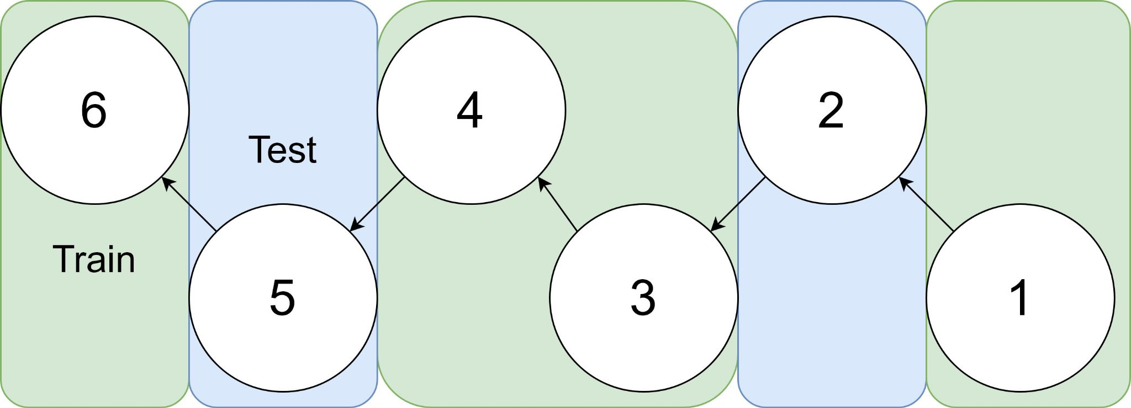
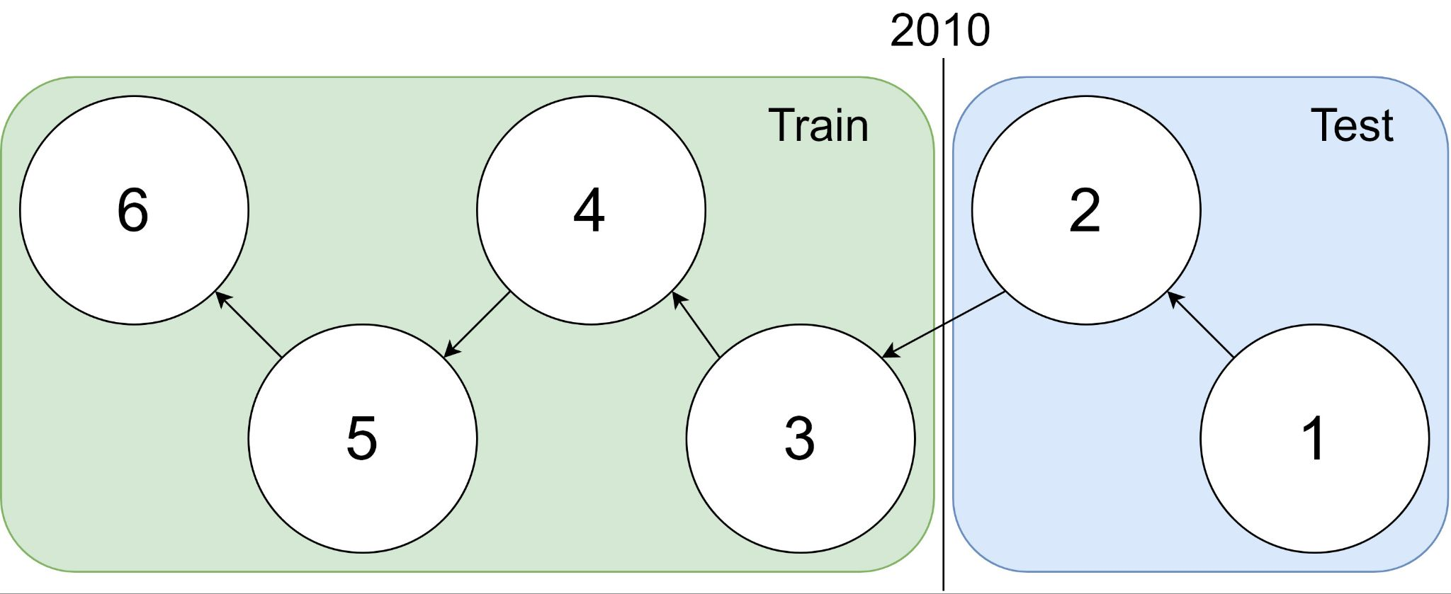
Example: 1 cites 2, 2 cites 3, … 5 cites 6
Traditional Train-Test Split (Non-Causal)
idx | Pub Year | Paper Title
1 | 2018 | [...] Photofragment imaging
2 | 2016 | Convenient probe of S(1D2)[...]
3 | 2005 | Megapixel ion imaging [...]
4 | 2003 | Direct current slice imaging [...]
5 | 1995 | profiles of Cl(2Pj) photofragments [...]
6 | 1988 | Adiabatic dissociation of [...]
Proposed Train-Test Splits (Causal)
Notes:
No asymmetry of time - how to reduce to a soundbite
Audience soundbites
‘Almost all studies in ml do test-train split’ that’s a bad idea when you have time

Slide 23
Standard Benchmarks (e.g., OGB, SciRepEval) are Small, Static & Clean
OGB (Open Graph Benchmark)
S2 (Semantic Scholar)
https://arxiv.org/pdf/2005.00687.pdf
Nodes (papers): 3M
Static
(Frozen for KDD-2021 CUP)
Train: before 2017
Validation: 2018
Test: 2019
Nearly all papers have both
Vectors (from word2vec)
Links (from citation graph)
Nodes (papers): 200+ M
Dynamic
Doubles every 9 years
Many papers with missing values
Many missing vectors
(because of missing abstracts)
Many missing links

Slide 24
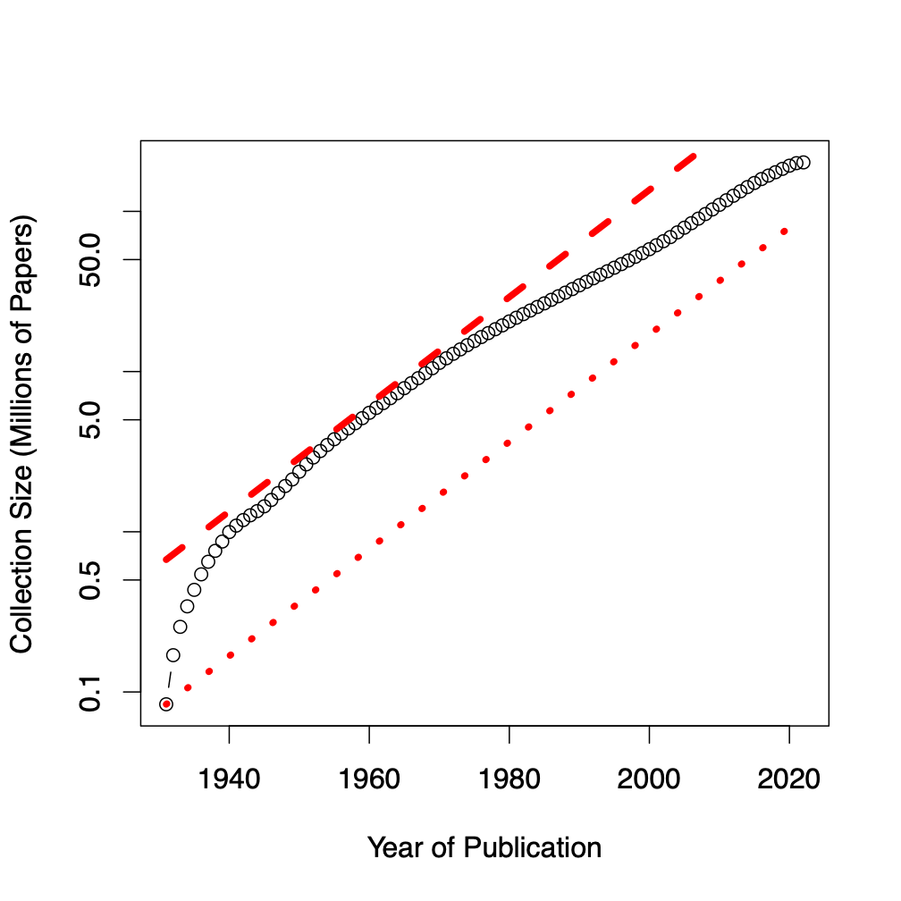
Benchmarks
Dataset | #N | #E | Node Raw Features
ogbl-citation2 | 3M | 31M | 128 (eg. word2vec)
Semantic scholar | 200M | 2B | 768 (eg. Bert)
GBs → TBs
Notes:
Graph showing growth

Slide 25
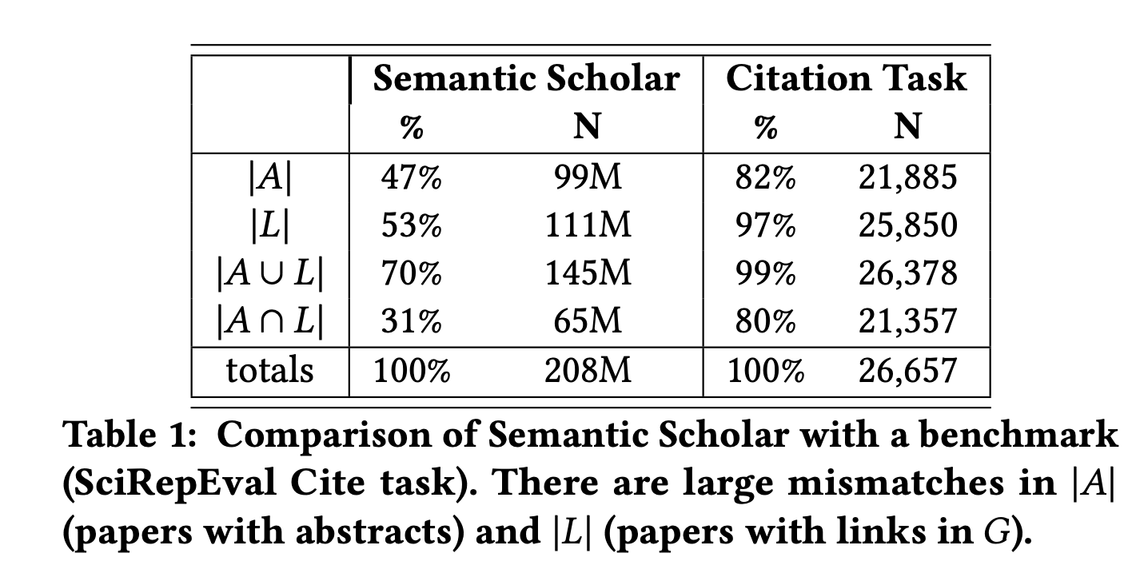
Standard Benchmarks are Small, Static & Clean
S2 (Semantic Scholar)
SciRepEval: Fewer Missing Values

Slide 26
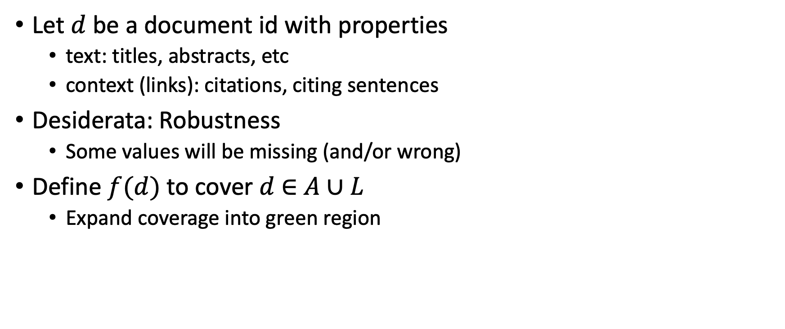

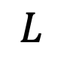
Suggestion for Missing Values
Let $d$ be a document id with properties
text: titles, abstracts, etc
context (links): citations, citing sentences
Desiderata: Robustness
Some values will be missing (and/or wrong)
Define $f(d)$ to cover $d$ $∈$ $A∪L$
Expand coverage into green region
$$A$$
$$L$$

Slide 27
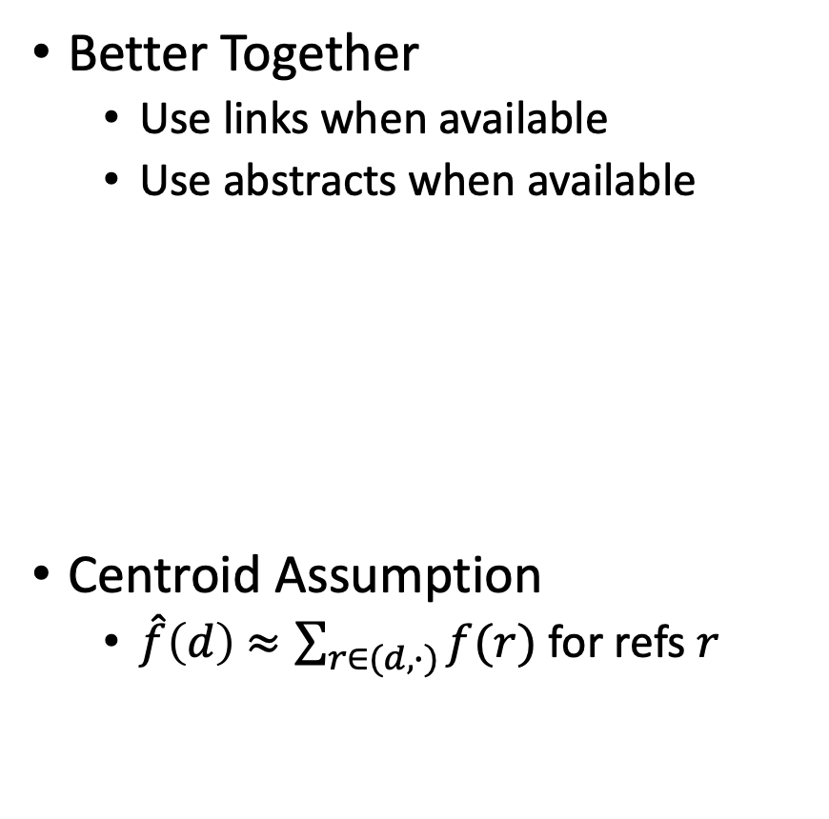

Estimates of $f(d)$ for $d$ $∉$ training set
It has been suggested that ProNE-like methods
do not generalize to documents beyond training set
Two methods for generalizing
Better Together
Centroid Assumption
Rodolfo & Peter
Better Together
Use links when available
Use abstracts when available
Centroid Assumption
$\hat{f}\left(d\right)$ $≈\sum_{r∈(d,∙)}{f(r)}$ for refs $r$

Slide 28
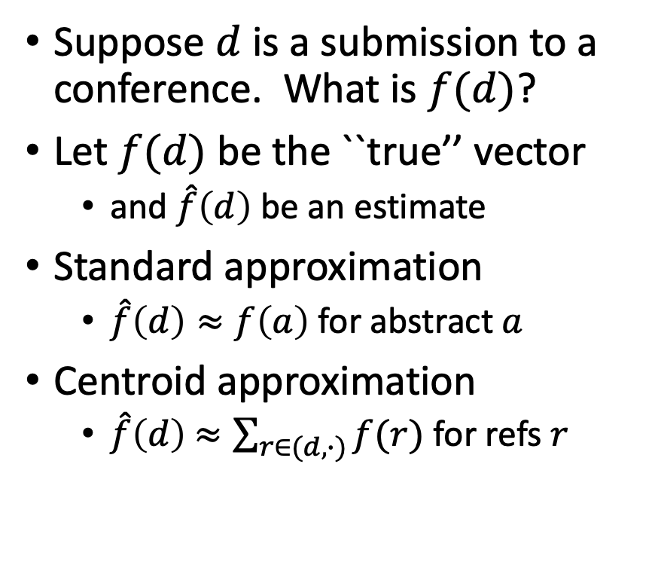
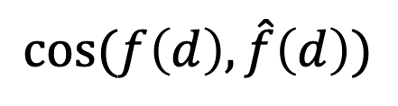
Centroid Assumption
Evidence for Centroid Approximation
$$cos⁡(f\left(d\right), \hat{f}\left(d\right))$$
Suppose $d$ is a submission to a conference. What is $f(d)$?
Let $f(d)$ be the ``true’’ vector
and $\hat{f}\left(d\right)$ be an estimate
Standard approximation
$\hat{f}\left(d\right)≈f\left(a\right)$ for abstract $a$
Centroid approximation
$\hat{f}\left(d\right)$ $≈\sum_{r∈(d,∙)}{f(r)}$ for refs $r$

Slide 29
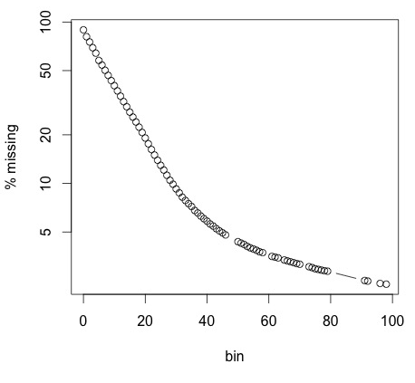
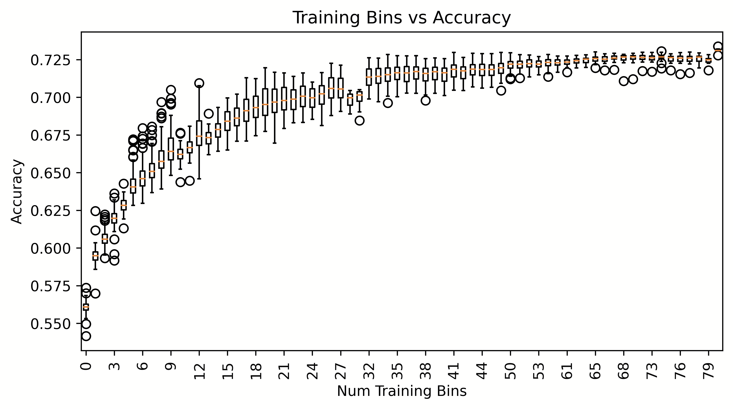
Proposal: Bins (Shabnam)
Research Questions:
How does performance/coverage scale
with size of citation graph?
How do losses scale with time?
Weather forecasting:
Short-term is easier than long-term
Better together:
Multiple reps → Ensembles
Production Runs
100x more work
Coverage
Peter
Ben
Performance

Slide 30
Resources & Evaluations: How do losses scale with size of citation graph?
We will distribute
Bins: CorpusIds
Graphs & Embeddings for bins
with indexes for ANN
Benchmarks for Experiments
Intrinsic
Perplexity
Random Walk
Year Prediction
Related-Work Hypothesis
Extrinsic
Link Prediction
Experimental Results
Perplexity Experiments
Abteen
Random Walk Experiments
Peter, Ken
Link Prediction Experiments
Peter
Year Prediction
Melissa, Shabnam
Related-Work Hypothesis
Rodolfo, John

Slide 31
How do time and space scale with size of graph?
Embeddings
Standard Embeddings
Specter, SciNCL, LinkBERT
Proposed embedding (ProNE)
Ben, Ken

Slide 32
Approximate Nearest Neighbors in External Memory
Kenneth Church

Slide 33
Opportunity for Publication
Well established:
Memory resident solutions (annoy)
Novelty:
External memory
mmap
Embarrassingly parallel
Standard evaluation benchmark
https://ann-benchmarks.com/
May not address advantages of proposed solution
Indexing time: small memory footprint during indexing, embarrassingly parallel
Inference time: small memory footprint, quick startup

Slide 34
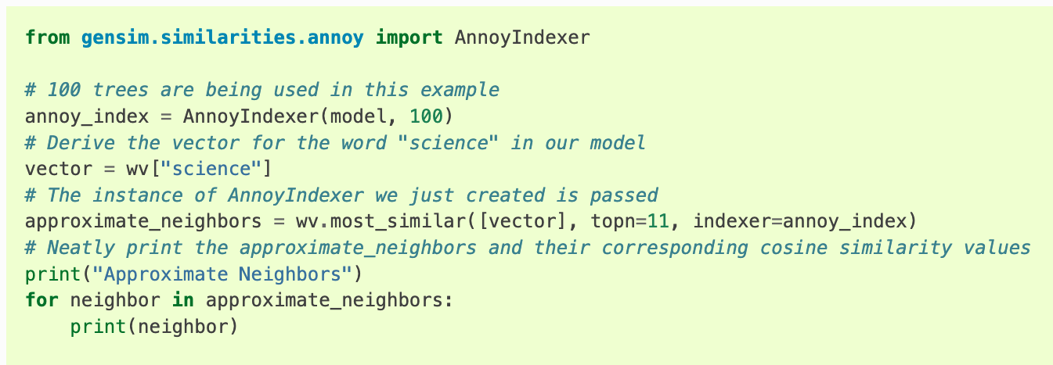
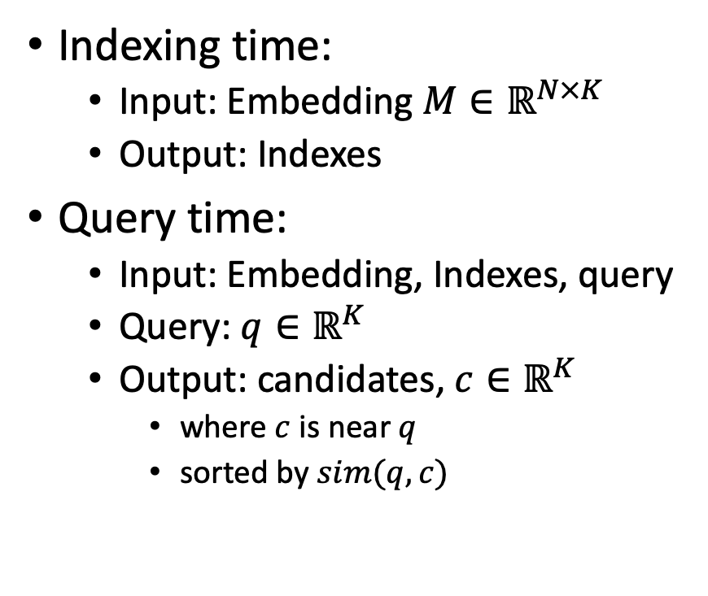
Processing with Embeddings: Annoy / Faiss Approximate Nearest Neighbors (ANN)
Indexing time:
Input: Embedding $M∈ℝ^{N×K}$
Output: Indexes
Query time:
Input: Embedding, Indexes, query
Query: $q∈ℝ^{K}$
Output: candidates, $c∈ℝ^{K}$
where $c$ is near $q$
sorted by $sim(q,c)$
https://radimrehurek.com/gensim/auto_examples/tutorials/run_annoy.html

Slide 35
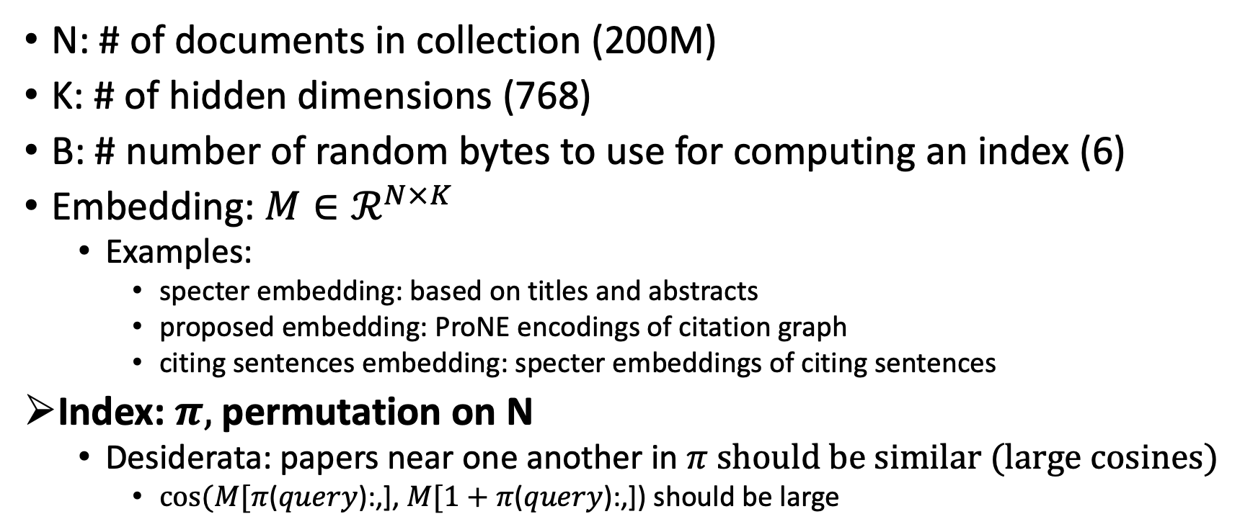
Notation
N: # of documents in collection (200M)
K: # of hidden dimensions (768)
B: # number of random bytes to use for computing an index (6)
Embedding: $M∈ℛ^{N×K}$
Examples:
specter embedding: based on titles and abstracts
proposed embedding: ProNE encodings of citation graph
citing sentences embedding: specter embeddings of citing sentences
Index: $π,$permutation on N
Desiderata: papers near one another in $π$ should be similar (large cosines)
$cos⁡(M[π$($query$):,], $M[1+π$($query$):,]) should be large

Slide 36
Memory Mapping (mmap in C; numpy.memmap in Python)
def map_int64(fn):
fn_len = os.path.getsize(fn)
return np.memmap(fn, dtype=np.int64, shape=(int(fn_len/8)), mode='r')
longs = (long *)mmapfile(av[++i], &nlongs);
nlongs /= sizeof(long);
Loads a large file (embedding) quickly
by adding file on disk to page table (without copying the contents)
returns a pointer to the contents (and the size of object in bytes)
If you dereference a pointer to virtual memory,
there could be a page fault (if the page is not in physical memory)

Slide 37
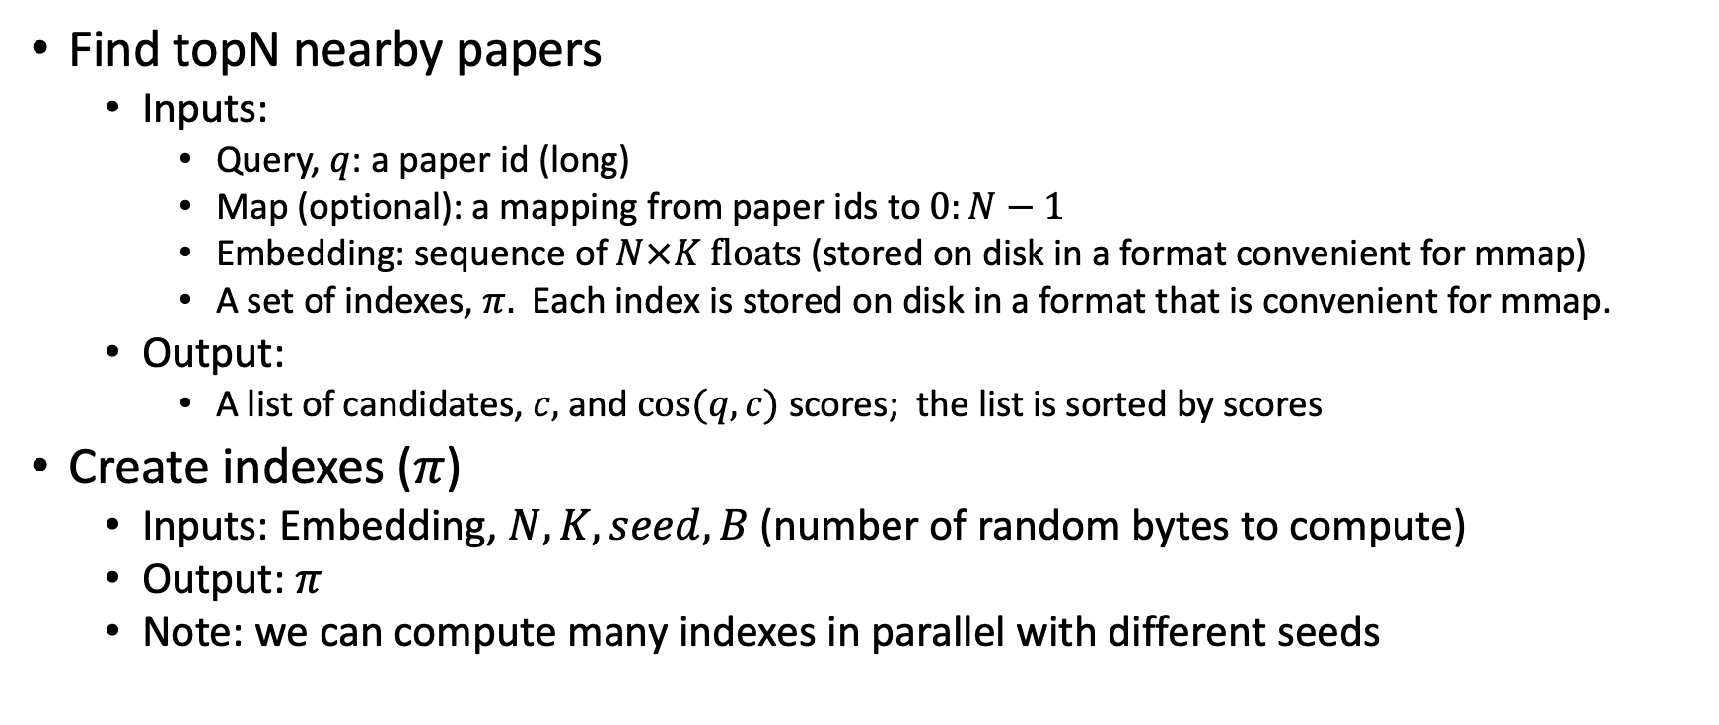
Problems to be done in external memory (Avoid loading embedding into memory)
Find topN nearby papers
Inputs:
Query, $q$: a paper id (long)
Map (optional): a mapping from paper ids to $0:N−1$
Embedding: sequence of $N×K floats$ (stored on disk in a format convenient for mmap)
A set of indexes, $π.$ Each index is stored on disk in a format that is convenient for mmap.
Output:
A list of candidates, $c,$ and $cos⁡(q,c)$ scores; the list is sorted by scores
Create indexes ($π$)
Inputs: Embedding, $N, K, seed, B$(number of random bytes to compute)
Output: $π$
Note: we can compute many indexes in parallel with different seeds

Slide 38

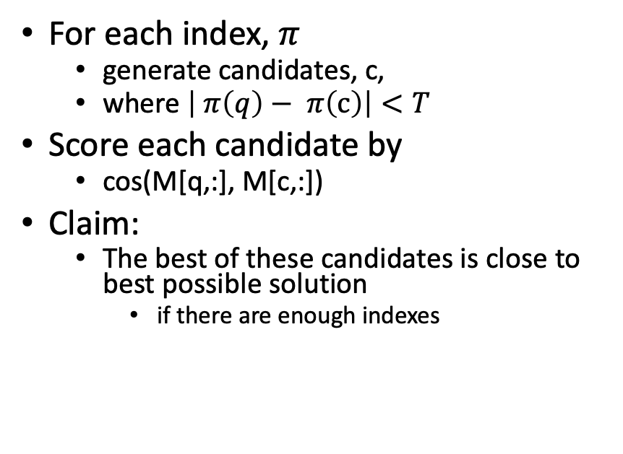
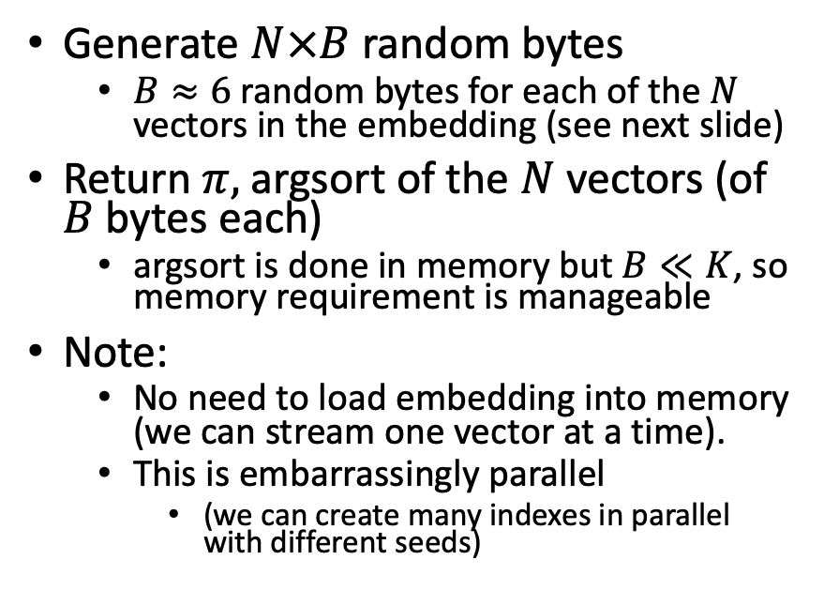
Solutions
Find topN nearby papers (easy)
Create index $π$
For each index, $π$
generate candidates, c,
where $\left| π\left(q\right)− π\left(c\right)\right|<T$
Score each candidate by
cos(M[q,:], M[c,:])
Claim:
The best of these candidates is close to best possible solution
if there are enough indexes
Generate $N×B$ random bytes
$B≈6$ random bytes for each of the $N$ vectors in the embedding (see next slide)
Return $π,$argsort of the $N$vectors (of $B$ bytes each)
argsort is done in memory but $B≪K$, so memory requirement is manageable
Note:
No need to load embedding into memory (we can stream one vector at a time).
This is embarrassingly parallel
(we can create many indexes in parallel with different seeds)

Slide 39
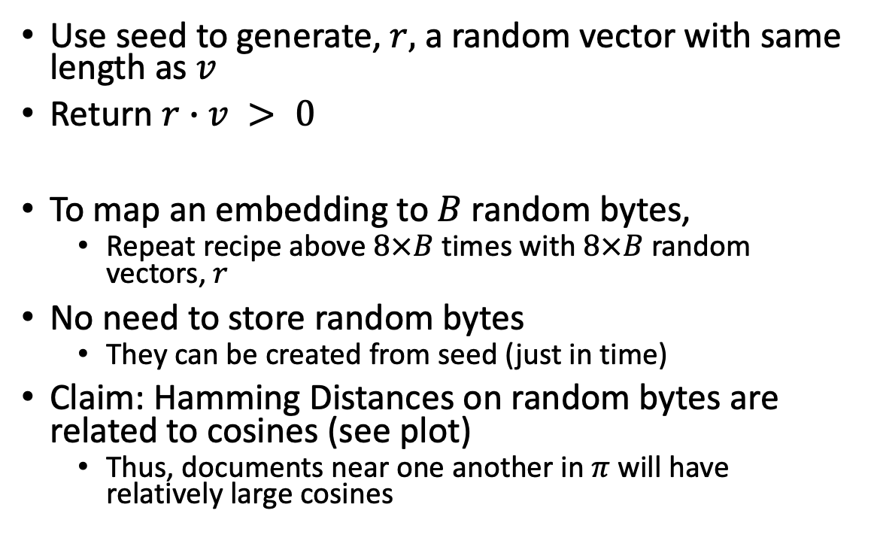

Method for mapping vector, $v$, to 1 bit
Use seed to generate, $r,$ a random vector with same length as $v$
Return $r∙v > 0$
To map an embedding to $B$ random bytes,
Repeat recipe above $8×B$ times with $8×B$ random vectors, $r$
No need to store random bytes
They can be created from seed (just in time)
Claim: Hamming Distances on random bytes are related to cosines (see plot)
Thus, documents near one another in $π$ will have relatively large cosines

Slide 40
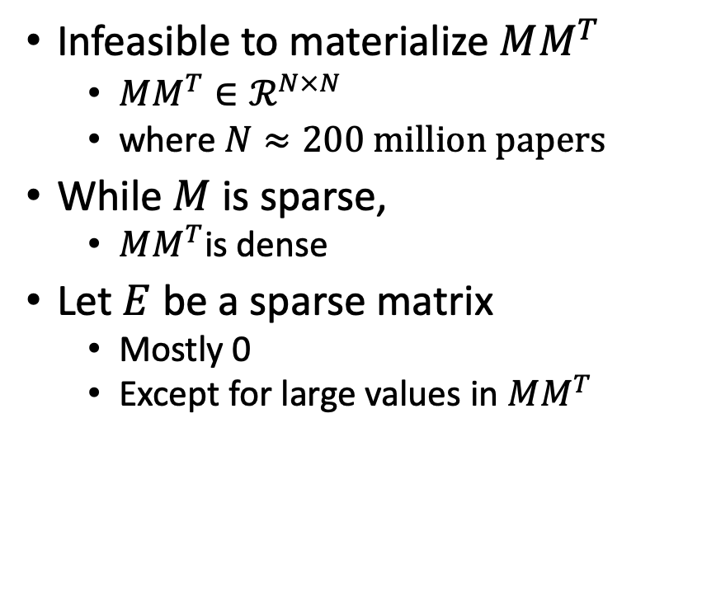

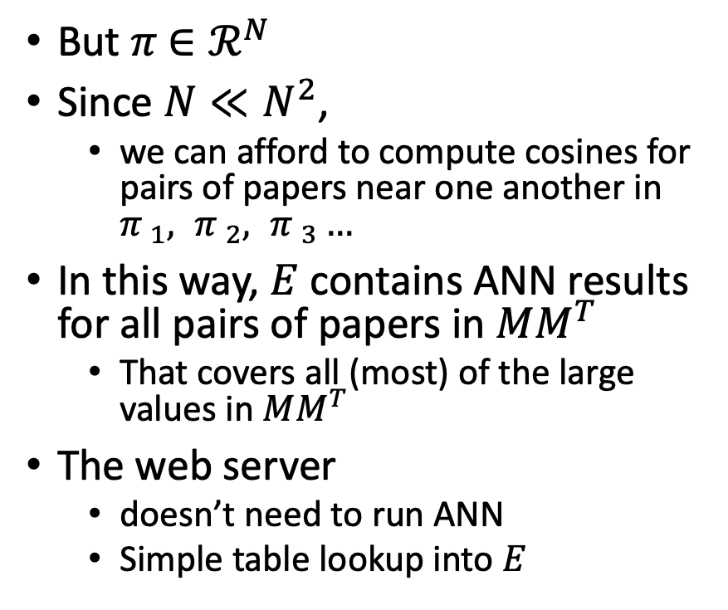
Materializing large values in $MM^{T}$
Infeasible to materialize $MM^{T}$
$MM^{T}∈ℛ^{N×N}$
where $N≈200 million papers$
While $M$ is sparse,
$MM^{T}$is dense
Let $E$ be a sparse matrix
Mostly 0
Except for large values in $MM^{T}$
But $π$ $∈ℛ^{N}$
Since $N≪N^{2}$,
we can afford to compute cosines for pairs of papers near one another in ${π }_{1}, {π }_{2}, {π }_{3}…$
In this way, $E$ contains ANN results for all pairs of papers in $MM^{T}$
That covers all (most) of the large values in $MM^{T}$
The web server
doesn’t need to run ANN
Simple table lookup into $E$

Slide 41
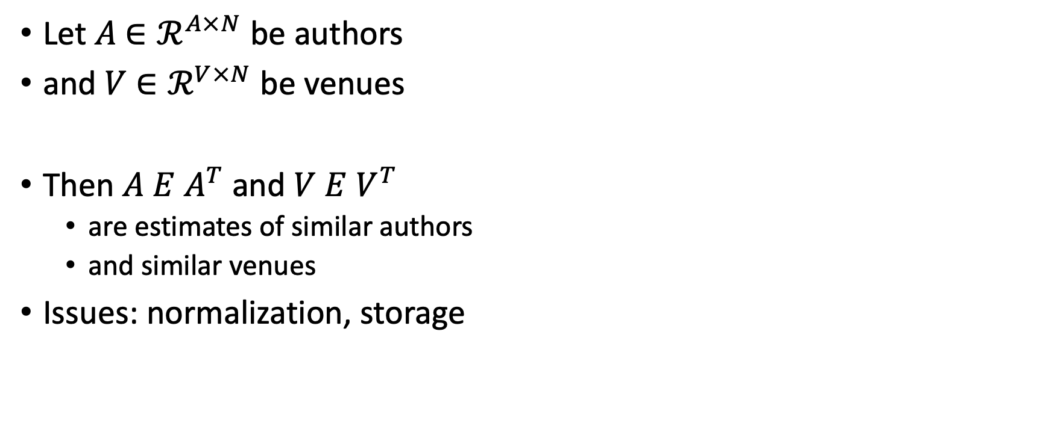
Similar Authors, Venues, etc.
Let $A$ $∈ℛ^{A×N}$ be authors
and $V$ $∈ℛ^{V×N}$ be venues
Then $A E$ $A^{T}$ and $V E$ $V^{T}$
are estimates of similar authors
and similar venues
Issues: normalization, storage

Slide 42
Conclusions/Deliverables
GitHub:
massive (but needs editing)
slides, code, reading list
pointers to large files on Globus
Web Server
Recommendations
Input: queries for documents
Output: recommendations (docs)
What Should I read? Cite?
Resources
Data behind web server:
citation graph
embeddings
indexes for approx. nearest neighbors
pairs of corpusIds with large cosines
all of the above for
Specter1, Specter2, SciNCL, ProNE
x100 bins for ProNE
Evaluations & Benchmarks
Intrinsic and Extrinsic evaluations
Perplexity, Random Walks, Link Prediction

Slide 43
Agenda
1.5 hours
1.5 hours
Intro (Ken) – 20 minutes
Centroids/Related Work
(Rodolfo) – 15 minutes
Bins
(Shabnam) – 15 minutes
Forecasting over time
Losses + Time & Space
Production Runs
(Ben) – 10 minutes
Time & Space
Break – 30 minutes
Experiments
Perplexity (Abteen) – 20 minutes
Random Walks (Peter) – 10 minutes
Link Prediction (Peter) – 10 minutes
Time prediction (Melissa) – 15 minutes
GNNs (Sandeep, Hui) – 15 minutes
Deliverables/Conclusions
(Ken) – 5 minutes
Questions – 15 minutes

Slide 44
backup

Slide 45
Production Runs: 80% Complete
 | 0 | 1 | 2 | 3 | 4 | 5 | 6 | 7 | 8 | 9
0 | ✓ | ✓ | ✓ | ✓ | ✓ | ✓ | ✓ | ✓ | ✓ | ✓
1 | ✓ | ✓ | ✓ | ✓ | ✓ | ✓ | ✓ | ✓ | ✓ | ✓
2 | ✓ | ✓ | ✓ | ✓ | ✓ | ✓ | ✓ | ✓ | ✓ | ✓
3 | ✓ | ✓ | ✓ | ✓ | ✓ | ✓ | ✓ | ✓ | ✓ | ✓
4 | ✓ | ✓ | ✓ | ✓ | ✓ | ✓ | ✓ | ✖︎ | ✖︎ | ✖︎
5 | ✓ | ✓ | ✓ | ✓ | ✓ | ✓ | ✓ | ✓ | ✓ | ✓
6 | ✖︎ | ✓ | ✓ | ✓ | ✖︎ | ✓ | ✓ | ✓ | ✓ | ✓
7 | ✓ | ✖︎ | ✖︎ | ✓ | ✓ | ✓ | ✓ | ✓ | ✓ | ✓
8 | ✓ | ✓ | ✖︎ | ✖︎ | ✓ | ✖︎ | ✖︎ | ✖︎ | ✖︎ | ✖︎
9 | ✖︎ | ✓ | ✓ | ✖︎ | ✖︎ | ✖︎ | ✓ | ✖︎ | ✓ | ✖︎

Slide 46
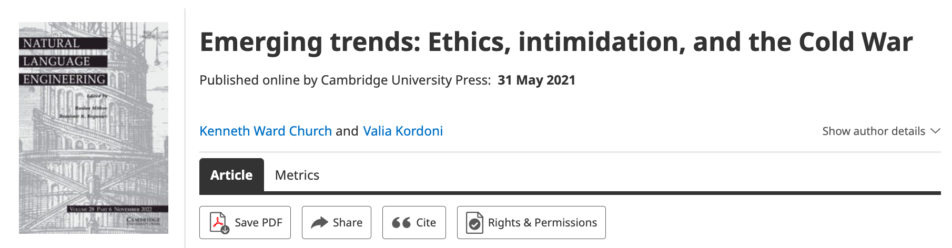
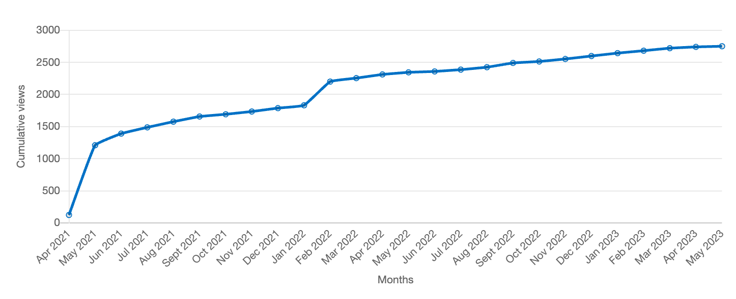
Value: Author Contributions + Audience Appreciation (Literature is a conversation, like social media)
Author Contributions
Time Invariant
Does not change after publication
Audience Appreciation
Evolves over time
Behavioral Signals
Views
Citations

Slide 47
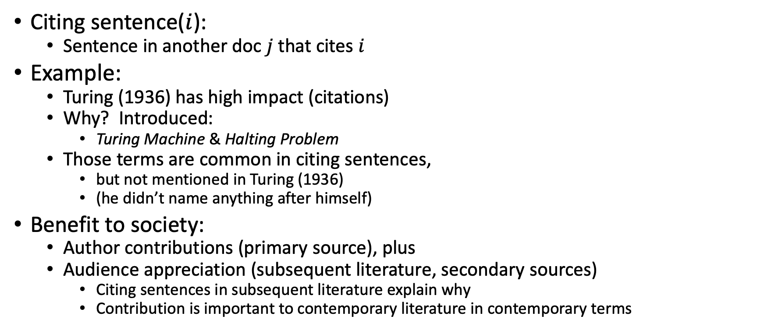
Citing Sentences
Citing sentence($i$):
Sentence in another doc $j$that cites $i$
Example:
Turing (1936) has high impact (citations)
Why? Introduced:
Turing Machine & Halting Problem
Those terms are common in citing sentences,
but not mentioned in Turing (1936)
(he didn’t name anything after himself)
Benefit to society:
Author contributions (primary source), plus
Audience appreciation (subsequent literature, secondary sources)
Citing sentences in subsequent literature explain why
Contribution is important to contemporary literature in contemporary terms
Anchor Text in Web Search

Slide 48



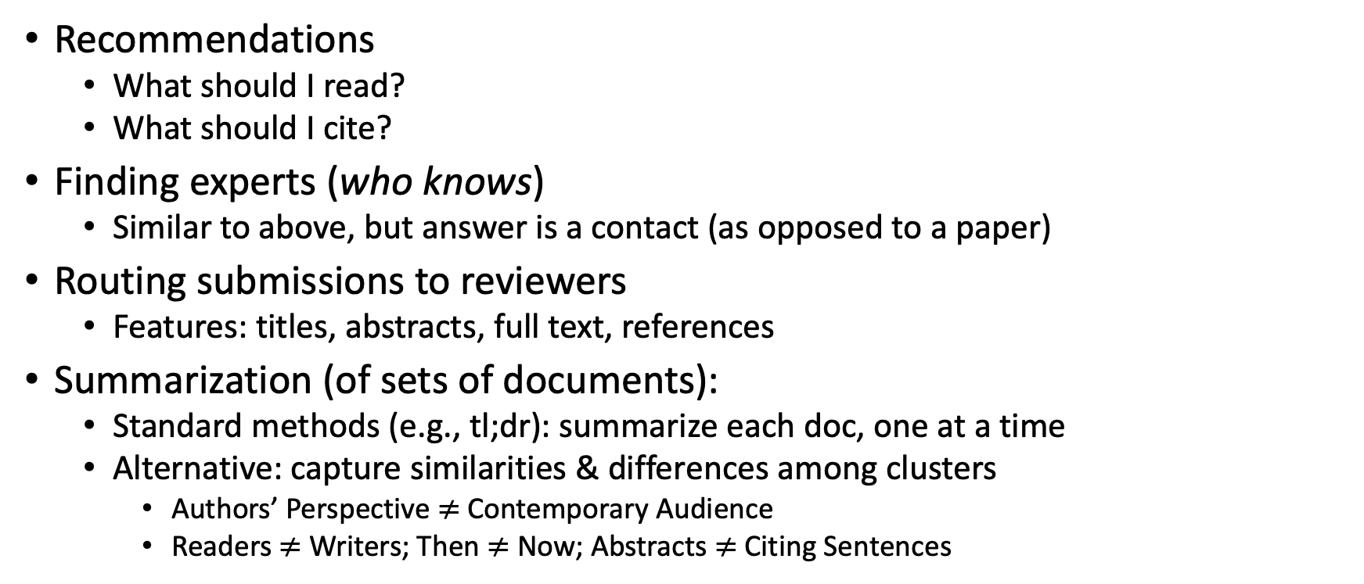
Document Similarities: Use Cases
Recommendations
What should I read?
What should I cite?
Finding experts (who knows)
Similar to above, but answer is a contact (as opposed to a paper)
Routing submissions to reviewers
Features: titles, abstracts, full text, references
Summarization (of sets of documents):
Standard methods (e.g., tl;dr): summarize each doc, one at a time
Alternative: capture similarities & differences among clusters
Authors’ Perspective $≠$Contemporary Audience
Readers $≠$ Writers; Then $≠$ Now; Abstracts $≠$ Citing Sentences

Slide 49
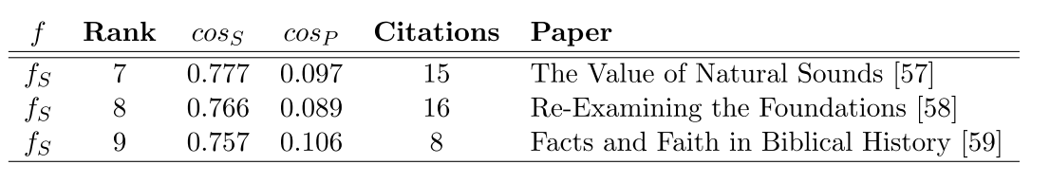
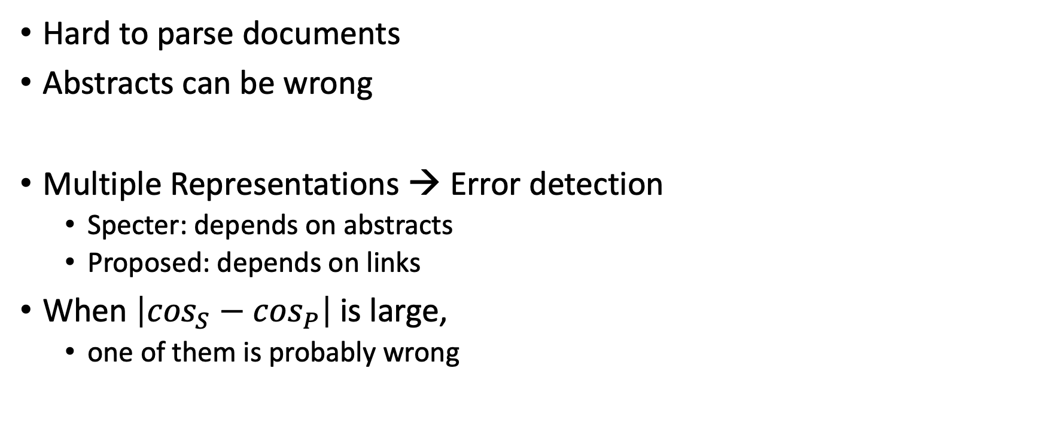
Bad/Misleading Values: Redundancy → Robustness
Hard to parse documents
Abstracts can be wrong
Multiple Representations → Error detection
Specter: depends on abstracts
Proposed: depends on links
When $\left|\cos_{S}−\cos_{P}\right|$is large,
one of them is probably wrong

Slide 50


Rank | Specter | Proposed | Paper
query | 1.000 | 1.000 | 1097: On stress and linguistic rhythm
1 | 0.908 | 0.926 | 0: Linguistic Society of America Structure and Intonation
2 | 0.895 | 0.977 | 475: Preliminaries to linguistic phonetics
3 | 0.885 | 0.921 | 25: Linguistic Society of America On the Definition of Word by
4 | 0.881 | 0.763 | 37: On some defferences between Chinese and Japanese '-Wh'-elements
5 | 0.880 | 0.946 | 2: Some accentuation properties in Japanese and lexical phonology
6 | 0.865 | 0.824 | 6: Two Types of Zi-Verbs in Japanese
7 | 0.777 | 0.097 | 15: The Value of Natural Sounds
8 | 0.766 | 0.089 | 16: Re-Examining the Foundations
9 | 0.757 | 0.106 | 8: Facts and Faith in Biblical History
1 | 0.578 | 0.998 | 226: The phonology of rhythm in English
2 | 0.530 | 0.997 | 74: A grid-based theory of English meter
3 | -1.000 | 0.996 | 5: "What does Phonology tell us about Stress and Rhythm? Some Reflections on the Phonology of Stress"
4 | 0.460 | 0.994 | 1: Syllable structure and stress in Bahdinani Kurdish
5 | 0.442 | 0.994 | 35: Schwa in phonological theory
6 | -1.000 | 0.994 | 163: The Sound Pattern of Russian: A Linguistic and Acoustical Investigation
7 | 0.542 | 0.993 | 27: Empirical evidence for a deletion formulation of the rhythm rule in English
8 | 0.552 | 0.993 | 95: Prosodic Structure Above the Word
9 | 0.334 | 0.993 | 0: Syllable Contraction in Cantonese A-not-A Constructions: An Optimality Account

Slide 51
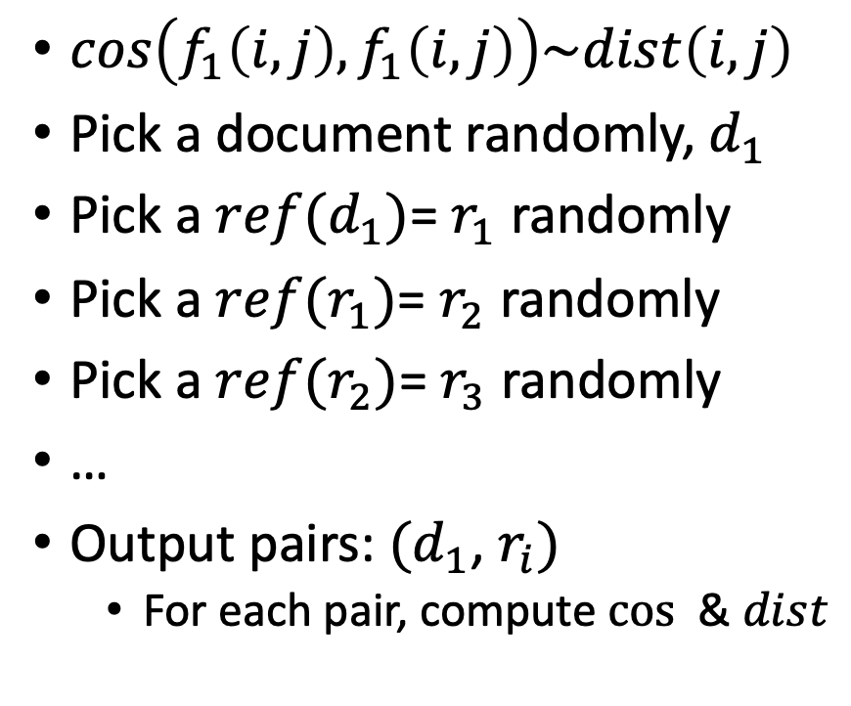
Random Walks
$cos\left(f_{1}\left(i, j\right),f_{1}\left(i, j\right)\right)\sim dist\left(i,j\right)$
Pick a document randomly, $d_{1}$
Pick a $ref(d_{1})$= $r_{1}$ randomly
Pick a $ref(r_{1})$= $r_{2}$ randomly
Pick a $ref(r_{2})$= $r_{3}$ randomly
…
Output pairs: $(d_{1}$, $r_{i})$
For each pair, compute $cos⁡$ & $dist$

Slide 52
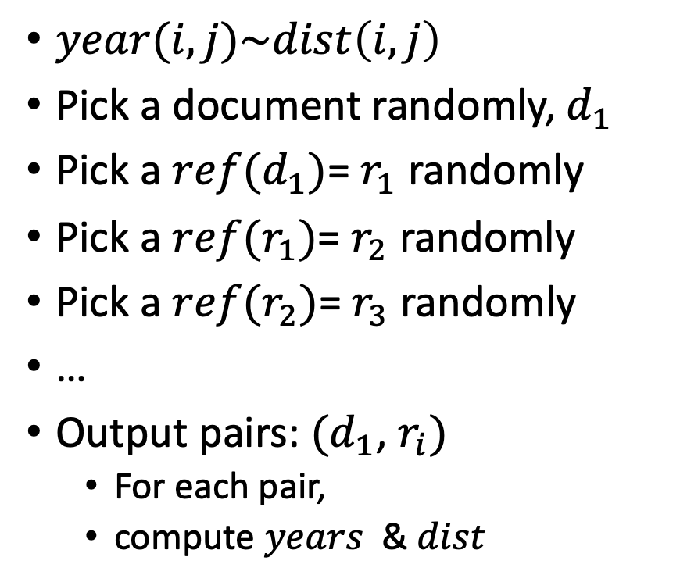
Random Walks
$year(i,j)\sim dist\left(i,j\right)$
Pick a document randomly, $d_{1}$
Pick a $ref(d_{1})$= $r_{1}$ randomly
Pick a $ref(r_{1})$= $r_{2}$ randomly
Pick a $ref(r_{2})$= $r_{3}$ randomly
…
Output pairs: $(d_{1}$, $r_{i})$
For each pair,
compute $years⁡$ & $dist$

Slide 53
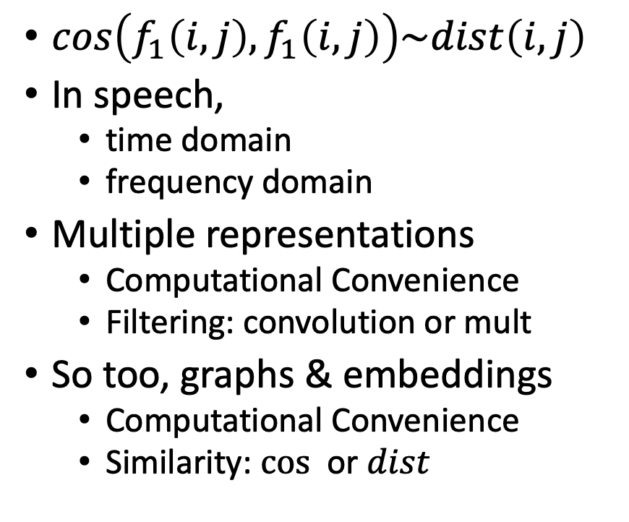
Cos-Dist: Multiple Views of Similarity
$cos\left(f_{1}\left(i, j\right),f_{1}\left(i, j\right)\right)\sim dist\left(i,j\right)$
In speech,
time domain
frequency domain
Multiple representations
Computational Convenience
Filtering: convolution or mult
So too, graphs & embeddings
Computational Convenience
Similarity: $cos⁡$ or $dist$

Slide 54
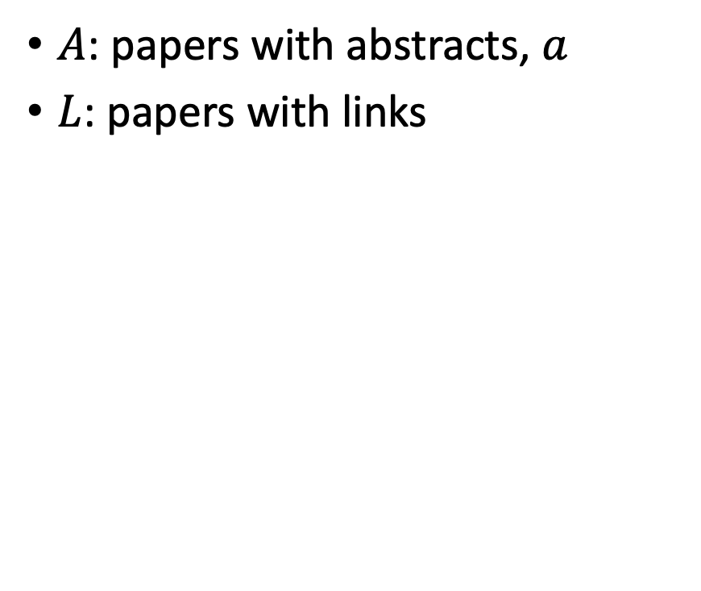
Realities: Missing Values
$A$: papers with abstracts, $a$
$L$: papers with links
Coverage | Pairs (Rand Walk) | Embedding
100% | 3,469,964 | Proposed
78% | 2,707,857 | Specter
35% | 1,216,506 | SciNCL
35% | 1,201,561 | Specter2
Standard Evaluations do not address coverage issues
API provides embeddings (but not abstracts)
for many papers

Slide 55
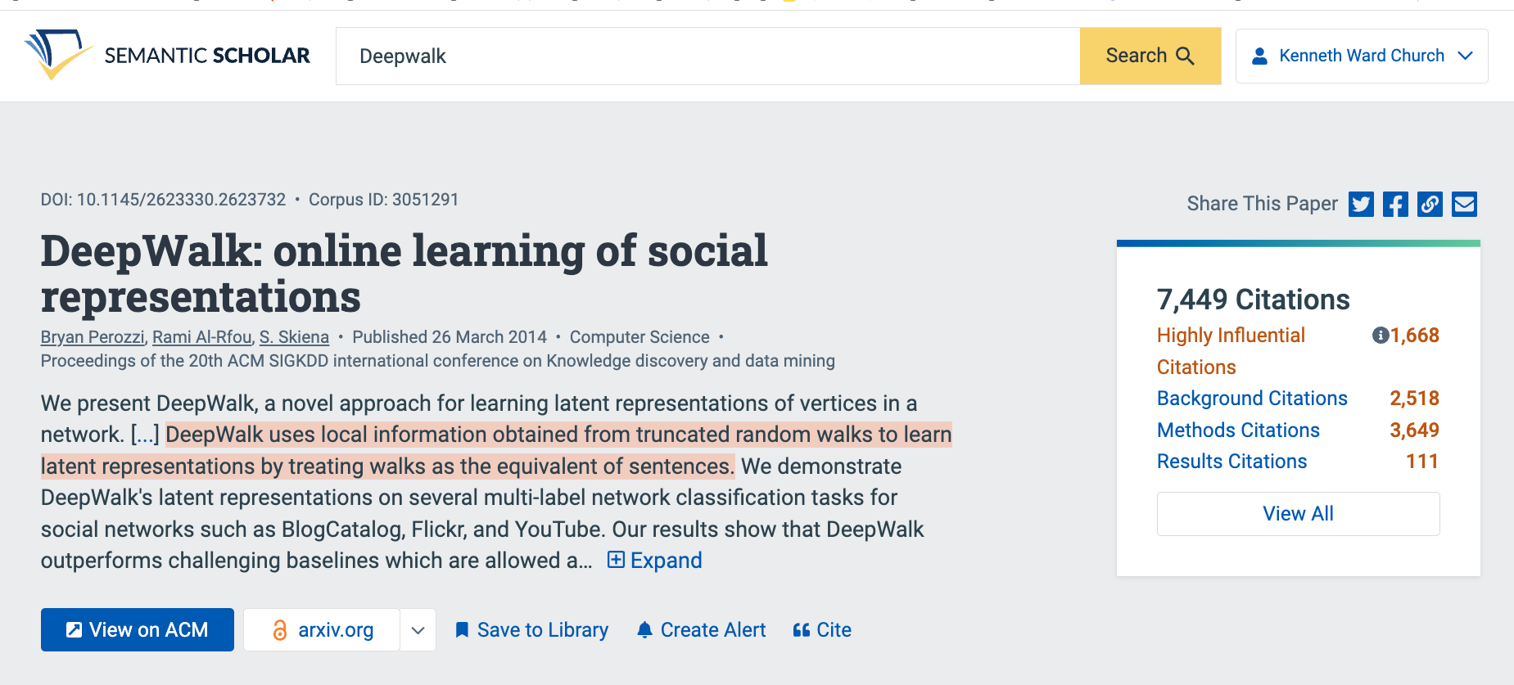
Summaries
Snippets
titles, authors, abstracts
tl;dr (too long; didn’t read)
Author Perspective:
These snippets
Audience Perspective:
Do these snippets capture 7k citations?
Why is this paper important
to contemporary readers?
Citing Sentences

Slide 56
Summarization Baselines
tl;dr
ChatGPT
⚠️ ⚠️ ⚠️ Warning ⚠️ ⚠️ ⚠️
Hallucinations

Slide 57
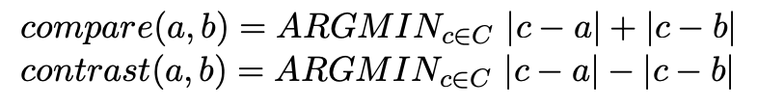
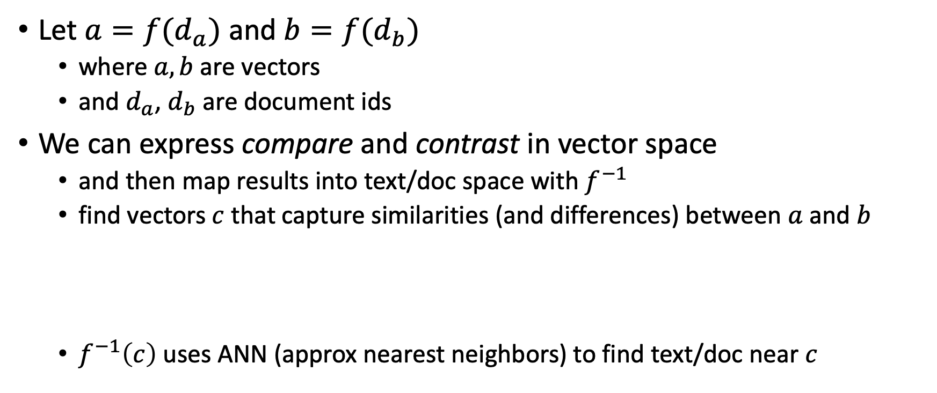
Summarization: Compare & Contrast (Do not summarize each doc, one at a time)
Let $a=f(d_{a})$ and $b=f(d_{b})$
where $a, b$are vectors
and $d_{a}$, $d_{b}$are document ids
We can express compare and contrast in vector space
and then map results into text/doc space with $f^{−1}$
find vectors $c$ that capture similarities (and differences) between $a$ and $b$
$f^{−1}\left(c\right)$ uses ANN (approx nearest neighbors) to find text/doc near $c$

Slide 58
Deliverables https://github.com/kwchurch/JSALT_Better_Together/blob/main/doc/deliverables.md
Better access to literature
Resources:
Many embeddings for many papers
Posted models on HuggingFace
Post code on GitHub
Summarization methods to compare and contrast across small (and large) collections of documents
Support incremental updates to embeddings based on citation graphs
Evaluation:
Better numbers,
as well as better benchmarks
Establish that combinations of text and links are better together (than either by itself)
Establish that citing sentences are useful
Improve methods for assigning papers to reviewers
Theory: Unified framework of
Deep nets and
Linear Algebra
Bibliometrics:
Predict citations of a paper over time.
Predict h-index of an author over time.
Find authors that publish too many papers

